Slide 1
HoMePIT Updates
By Erik Anderson, Jerome Chestnut, and Maxwell Fugette

Slide 2
Outline
Introduction
Current Changes
App changes
Database changes
Considered Changes
App changes
Database changes
Accomplishments
What needs implementation
Issues

Slide 3
Current Changes, App
Early on, it was decided to switch from Replit to VSCode as our primary IDE due to familiarity and freedom of development.
Using the Next.js template with Replit forces the user to use TypeScript, which we did not want.
Replit seemed to complicate things such as version control, user authentication, and using Supabase.
Replit will still be used for hosting purposes, but only for the demo.

Slide 4
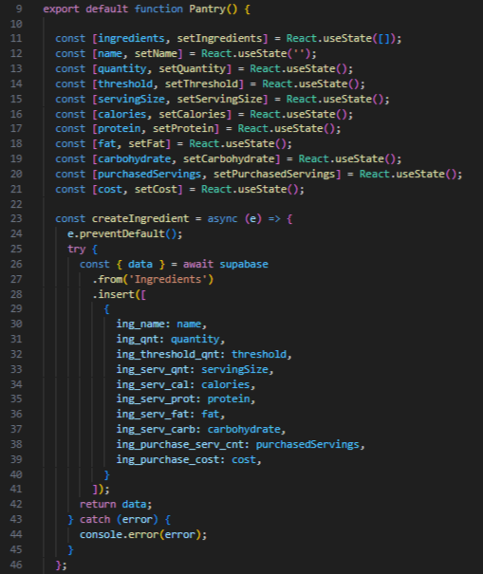
Current Changes,
App pt.2
Using React’s useState() hook simplified assigning attributes to ingredients.
The Pantry, Recipes, and Meal pages were overhauled to have essentially the same format, with state hooks, CRUD methods, and the HTML display.

Slide 5
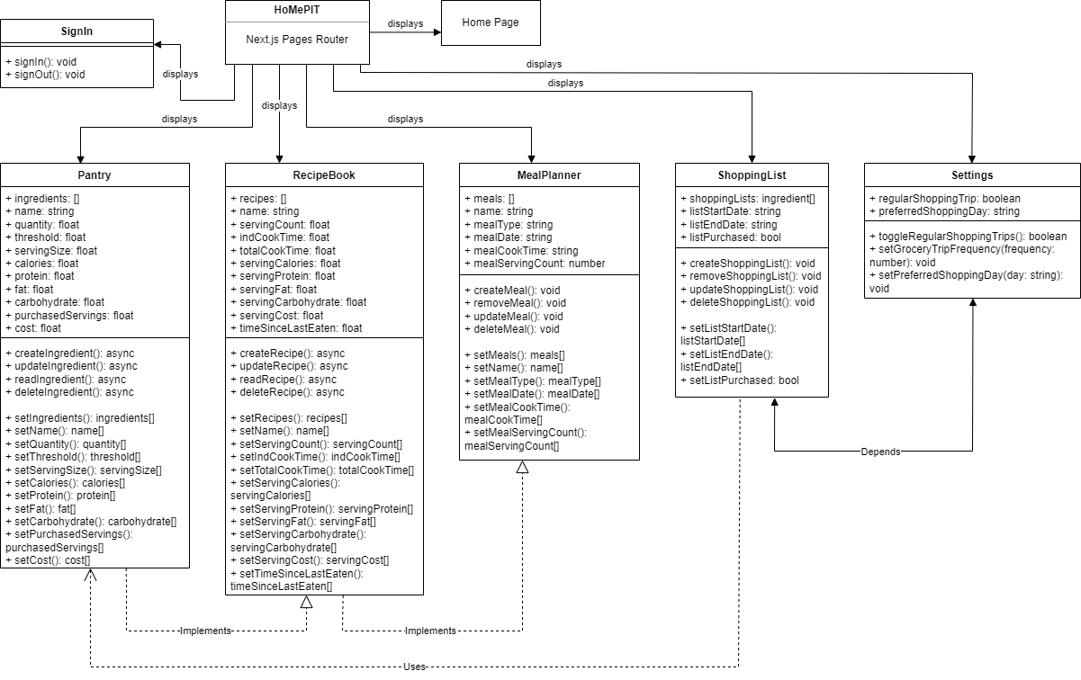

Slide 6
Current Changes, Database
User ID added to every table
Row Level Security policies added to every table
Only the owner of info can interact with it
Added nutrient stats & cost to “Recipe Ingredients”
“Recipe” nutrient stats & cost update on trigger
Added “Ingredient Audit” table and related functions

Slide 7
Current Changes, Database pt. 2
Cutting substitution, sub-recipe, leftovers, and expiry date functionality
Removed “Units” table
Likely cutting shopping list purchase location optimization
May cut purchase location functionality overall

Slide 8
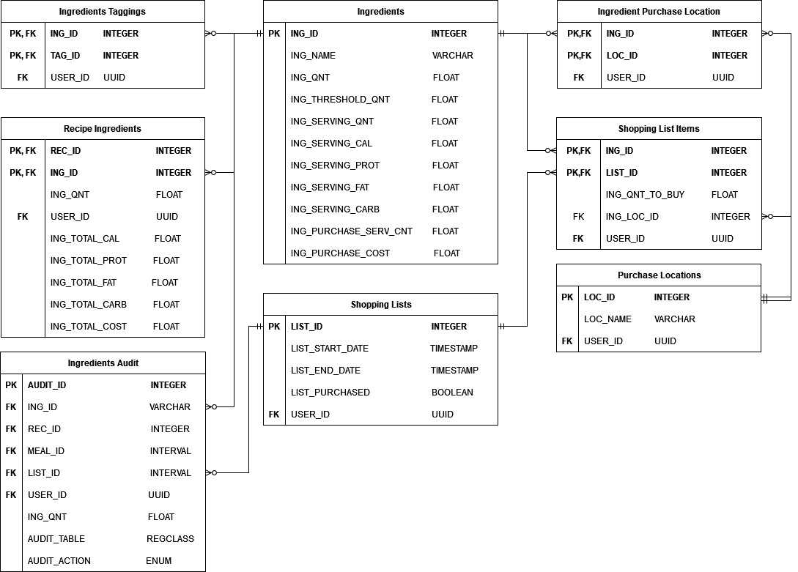

Slide 9
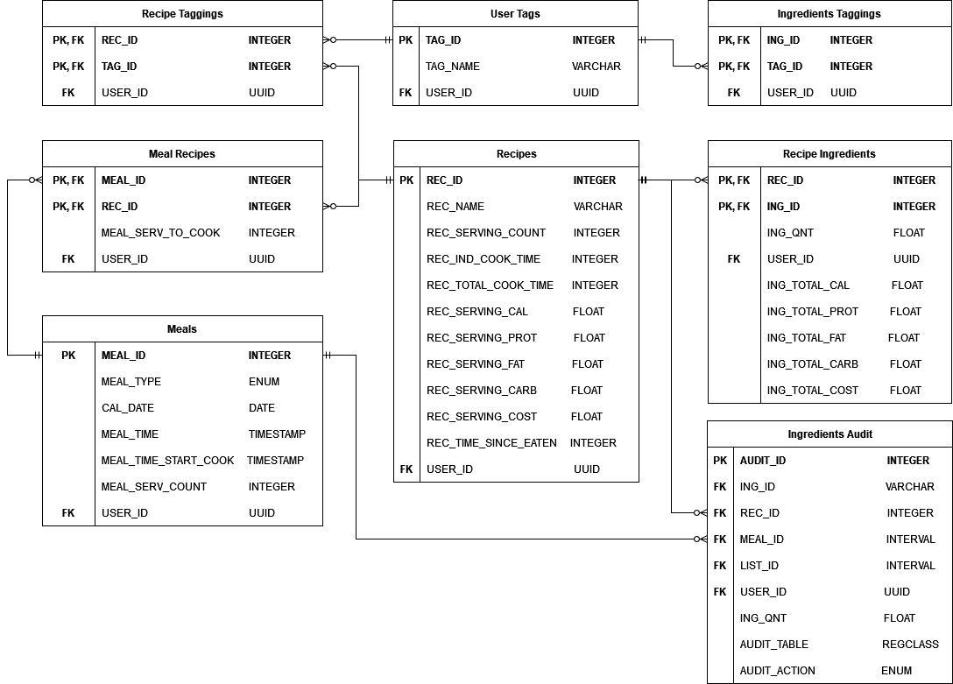

Slide 10
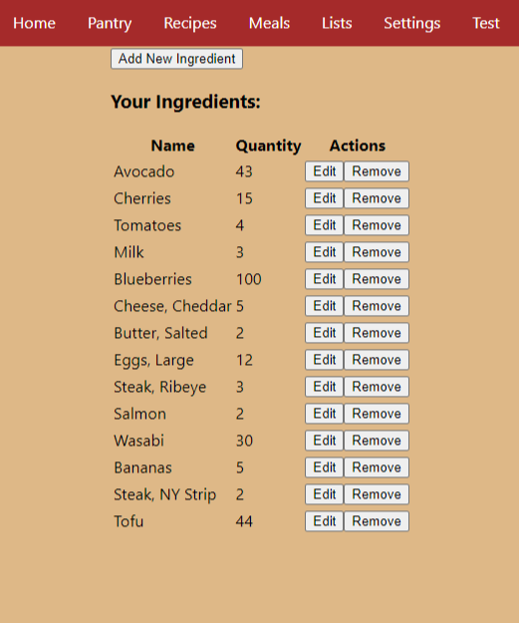
Completed Accomplishments, App
Authentication (almost) successfully implemented.
User can create, update, and delete ingredients, recipes, and meals, and see those changes reflected in the page they are on.
Site is responsive and updates accordingly, given changes in the database.

Slide 11
Completed Accomplishments, Database
General database tables added
“Recipe” and “Recipe Information” automatically update nutrition & cost info
Caused by certain actions in “Ingredients”, “Recipe Ingredients”, and “Recipes”
“Ingredients Audit” table added

Slide 12
Partially Complete, App
User authentication works, however after sign in the user is incapable of altering the contents of the database.
Users can input data for ingredients/recipes/meals, but that data is unique to the instance of that object.
i.e. if the user were to create two ingredients with the same attributes, they would be represented as separate instead of being the same.
A calendar component has been implemented for the Meal Planner, but has no functionality.

Slide 13
Partially Complete, Database
Some “Ingredients Audit” auditing functions added
Can be triggered by actions on most tables
“Ingredients”, “Recipe Ingredients”, “Recipes”, “Meal Recipes”, “Meals”, “Shopping List Ingredients”, and “Shopping Lists”
Each trigger has unique potential impact - not generalizable

Slide 14
Still to be Implemented, App
Data validation has yet to be implemented in the frontend.
If the user were to create an ingredient named “Tomatoes” and set the quantity as “Four”, this would result in an error in the console but not to the user.
Unit conversion has yet to be implemented, which is a core component.
Inputting “5” as the user’s quantity of Salmon does not make sense. “5 lbs” would be more applicable.
The entire Meal Planning component needs to be implemented, along with cost and nutrition data tracking.
The Shopping List component has not yet been implemented, along with the associated Settings page.

Slide 15
Still to be Implemented, Database
Shopping List generation
Shopping List updating
Shopping List purchase location optimization
Assuming this doesn’t get cut due to time
General database access utility functions

Slide 16
Issues
Minor / major: shopping list functionality may be cut due to time constraints.
First to be cut: purchase location optimization
Second: overall purchase location functionality
Minor: cutting of substitution, sub-recipes, leftovers, and expiry dates
Impacts quality of life, not core functions
Minor: issues with some css elements
Most borders are not appearing
The alignment of content is off on some pages

